Slide 1
BANSKO, 26.08.-31.08.2013.
13th Workshop
“Software Engineering Education
and Reverse Engineering
Survey of model-driven techniques
for database model synthesis
Dražen Brđanin, Slavko Marić
Faculty of Electrical Engineering, University of Banja Luka, Bosnia and Herzegovina

Slide 2
Agenda
Background
  Motivation. Research Participants.
Introduction
  Conceptual Data Model Design Approaches. Model-driven CDM – Basic Idea. Short overview of research in the field of model-driven approaches.
Related work
Classication of model-driven approaches
function-oriented,
process-oriented,
communication-oriented, and
goal-oriented.
Comparative Analysis
Conclusion

Slide 3
Background
Motivation
The database model is one of the most important artifacts in the process of information system design. The continual research goal is to make this phase as easier as possible (ideally fully automated).
The automation of data model design has been subject of research for many years, with the conceptual data model (CDM) as the main target.
Many different approaches and techniques for data model design/synthesis has been proposed so far. Motivation for work: lack of appropriate survey of research and achievements in one important area: the model-driven approaches and techniques for data model design/synthesis.
Research participants
Research conducted by mr Dražen Brdjanin, as part of his work on PhD thesis
dr Slavko Marić, advisor
Notes:
The database model is one of the most important artifacts in the process of information system design, as well as the crucial component of software system models. Similar to the other steps in the development process, the continual research goal is to make this phase as easier as possible (ideally fully automated).
As a consequence, the automation of data model design has been subject of research for many years. The main target is conceptual data model (CDM), because transformation from conceptual data model to other data models (⇒ implementation logical level ⇒ physical level) is more or less straightforward.
Many different approaches and techniques for data model design/synthesis has been proposed so far. Our work was inspired by the lack of appropriate survey of research and achievements in one important group: the model-driven approaches and techniques.

Slide 4
Introduction (1/4)
Conceptual Data Model Design Approaches
The most frequently used approaches to conceptual database design: NLP (Natural Language Processing) approaches
The main flaw: The effectiveness and limitations of this approaches deeply depend of the natural language characteristics.
Other approaches:
  Forms based approaches
    Many data are gathered or reported in a form, so forms are starting point for analysis and database design.
  Model based approaches
    take models, i.e. graphically specified business or software requirements, as the basis for automated data model design.
  Our research is focused on model based approaches, because
  Business modeling (usually) proceeds conceptual data modeling step,
  Models are based on formal concepts ⇒ automation process is easier
Notes:
● The most frequently used approaches to conceptual database design are NLP (Natural Language Processing) approaches, that are based on extracting knowledge from requirements specifications in natural language, in order to automate data model design.
Flavor: The effectiveness and limitations of this approaches are usually deeply related to the natural language characteristics, and their utilization is questionable for languages with complex morphology.
● Other approaches:
Forms based approaches and
Model based approaches, that take models, i.e. graphically specified business or software requirements, as the basis for automated data model design.
Our research is focused on model based approaches, because
Business modeling (usually) proceeds conceptual data modeling step,
Models are based on formal concepts ⇒ automation process is easier

Slide 5
Introduction (2/4)
Conceptual Data Model Design Approaches
CDM
Linguistics-based
approaches
?
Model-based
approaches
Forms-based
approaches
Textual specification of information requirements
UML AD
BPMN

Slide 6
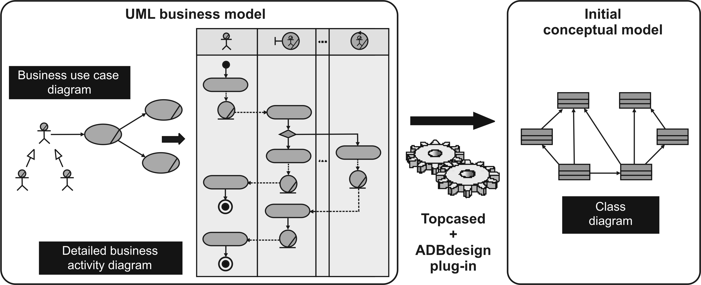
Introduction (3/4)
Automated Model-driven CDM – Basic Idea
?

Slide 7
Introduction (4/4)
Breaf history of research in the field of Model-driven Approaches
The first ideas and papers related to model-driven design of the data models appeared in the second half of the 1980s.
The first papers reporting the model-driven tools for (semi)automatic data model synthesis were published in the mid-1990s.
The fully automated model-driven synthesis of the data model is still the subject of intensive research.
In the related literature there are no papers presenting the systematic literature review (SLR) in the field of model-driven approaches and techniques for conceptual data model synthesis.
Our research and this presentation aims to give a survey and systematization of approaches and techniques in this field.
Notes:
The OMG's efforts focused on UML, MDA and QVT have made significant contributions to the automated model-driven synthesis of data models in the 2000s.
However, although the idea of model-driven design of the data model is more than 25 years old, the fully automated model-driven synthesis of the data model is still the subject of intensive research. In the existing literature there are only a small number of papers presenting the implementation of the automatic model-driven generator of the target data model with the corresponding evaluation results, while the great majority of papers only present modest achievements in (semi)automated, or even manual, data model synthesis.
Several existing papers give only a partial overview of the field by focusing on some particular source notation or by presenting a wider overview of techniques for synthesizing different (not only data) models and taking different source (not only graphical) specifications as the base.

Slide 8
Related work
Jilani et al. [1] present a comparative study of seven approaches for the synthesis of UML diagrams based on data flow diagrams (DFD)
  not focused on data model synthesis and does not cover all existing approaches taking the DFD as a starting point.
Franch et al. [2] present the classification of the combined usage of the i* notation with other notations and modeling frameworks.
  only two of all identified papers address the synthesis of data models based on i*.
Loniewski et al. [3] present the SLR of the use of requirements engineering techniques in model-driven software development.
  not primary focused on the model-driven synthesis of the data model, and only a few papers, out of approximately 70 identified, belong to the target group of model-driven approaches to data model synthesis.
Yue et al. [4] present the SLR of transformation approaches between user requirements and analysis models,
  this review is focused on the textual specification of user requirements as a starting point.
Notes:
IBM: The analysis model
The analysis model describes the structure of the system or application that you are modeling. It consists of class diagrams and sequence diagrams that describe the logical implementation of the functional requirements that you identified in the use case model.
You can think of the analysis model as the foundation of the design model since it describes the logical structure of the system, but not how it will be implemented.

Slide 9
Classification of Model-driven approaches
We have conducted an extensive survey of the related literature and identified more than 70 primary sources.
Based on the primary focus of a source notation, we have classified all identified papers into four main groups:
function-oriented,
process-oriented,
communication-oriented, and
goal-oriented.
Table 1. Distribution of papers according to focus of source notation
Source notation | Function-oriented | Process-oriented | Communication-oriented | Goal-oriented
Number of papers | 22 | 36 | 10 | 11
Notes:
● We have conducted an extensive survey of the related literature and identified more than 70 primary sources (articles, conference papers, PhD theses) addressing the model-driven synthesis of the data model (MDSDM).

Slide 10
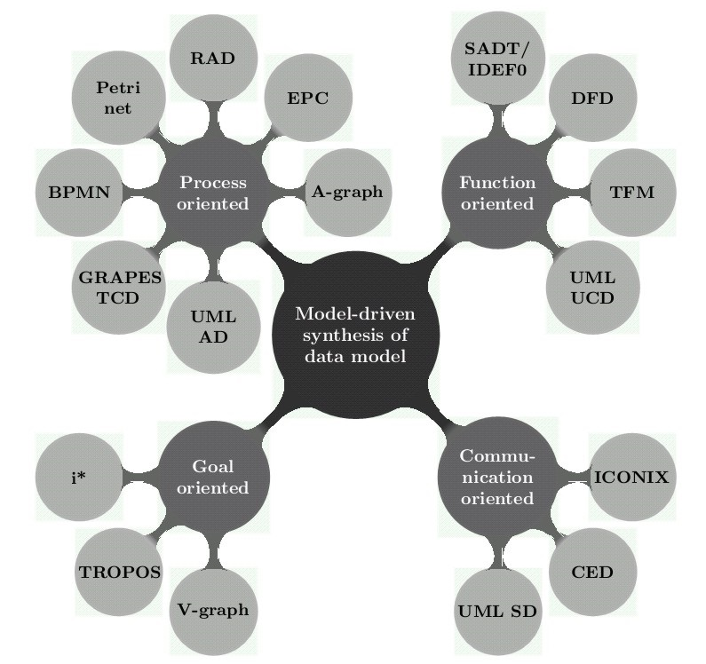
Classification of Model-driven approaches for DM synthesis
Taxonomy of source notations in MDSDM
Notes:
Taxonomy: the science or technique of classification.
TFM has a solid mathematical base. It is represented in a form of a topological space (X,Θ), where X is a finite set of functional features of the system under consideration, and Θ is the topology that satisfies axioms of topological structures and is represented in a form of a directed graph. A TFM has topological (connectedness, closure, neighborhood, and continuous mapping) and functional (cause-effect relations, cycle structure, and inputs and outputs) characteristics. It consists of the following steps: 1) Definition of physical or business functional characteristics; 2) Introduction of topology; and 3) Separation of the topological functioning model.
GRAPES-BM/TCD> Large tasks are decomposed into chains of smaller ones using Task Communication Diagrams (TCD). These diagrams are the basic ones in GRAPES-BM (Business modeling language). The business modeling language GRAPES-BM is a semiformal graphic language for modeling and simulation of complicated business systems (production processes, offices, information systems). GRAPES-BM relies on such basic concepts as task, event, performer, triggering condition etc. and contains advanced facilities for describing system behavior.
RAD (Role Activity Diagram): a notation originally developed for software process modeling. RAD shows the roles, their component activities, and their interactions together with external events and the logic that determines what activities are carried out when. Have been used and promoted in the UK by both Praxis and Co-Ordination Systems.
ICONIX process is UML Use Case driven but more lightweight than RUP. Unlike the XP and Agile approaches, ICONIX provides sufficient requirement and design documentation, but without analysis paralysis. The ICONIX Process uses only four UML based diagrams in a four step process that turns use case text into working code.
The i* framework proposes an agent-oriented approach to requirements engineering centering on the intentional characteristics of the agent. Agents attribute intentional properties (such as goals, beliefs, abilities, commitments) to each other and reason about strategic relationships. Dependencies between agents give rise to opportunities as well as vulnerabilities. Networks of dependencies are analyzed using a qualitative reasoning approach. Agents consider alternative configurations of dependencies to assess their strategic positioning in a social context.
The framework is used in contexts in which there are multiple parties (or autonomous units) with strategic interests which may be reinforcing or conflicting in relation to each other. Examples of such contexts include: business process redesign, business redesign, information systems requirements engineering, analyzing the social embedding of information technology, and the design of agent-based software systems.

Slide 11
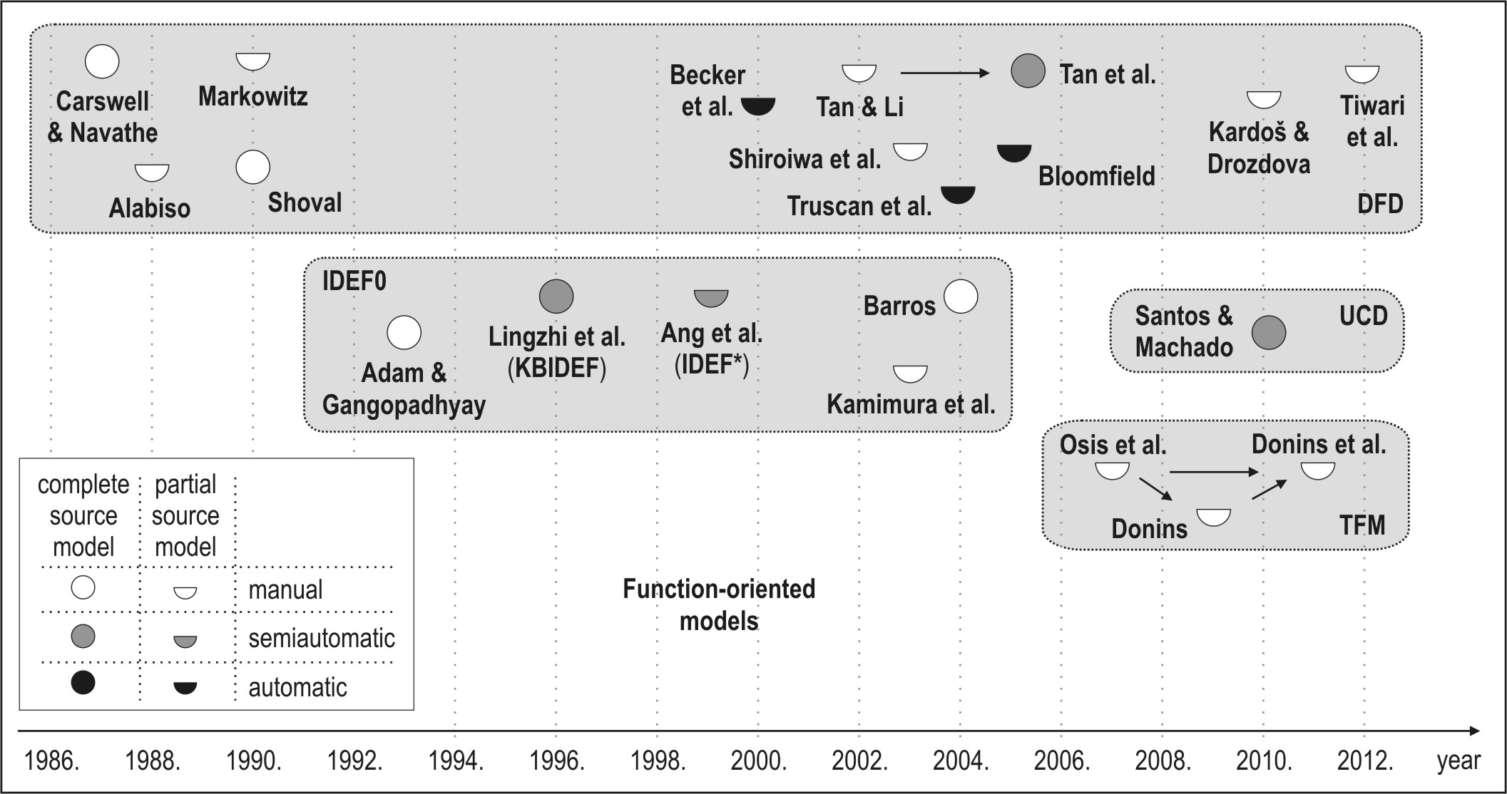
Function oriented approaches (1/3)
Chronological overview and main characteristics of FO approaches
Notes:
Functional approach offer many advantages both in analysis, design and implementation. A modelled system may be mathematically formalized as mapping (function) from the set of inputs I to the set of outputs O. This provides so-called black-box view of system. In the functional model, specification consists of functions.
TFM (Topological Functioning Model) has a solid mathematical base. It is represented in a form of a topological space (X,Θ), where X is a finite set of functional features of the system under consideration, and Θ is the topology that satisfies axioms of topological structures and is represented in a form of a directed graph. A TFM has topological (connectedness, closure, neighborhood, and continuous mapping) and functional (cause-effect relations, cycle structure, and inputs and outputs) characteristics. It consists of the following steps: 1) Definition of physical or business functional characteristics; 2) Introduction of topology; and 3) Separation of the topological functioning model.

Slide 12
Function oriented approaches (2/3)
The first ideas about the MDSDM based on function-oriented models (FOMs) in the second half of the 1980s. The first implementations of (semi)automatic generators of CDM in the mid-1990s.
FOMs use four different notations: DFD, SADT/IDEF0, TFM (Topological Functioning Model) and UML UCD (Use Case Diagram).
DFD has been commonly used (>50%) as a starting point for the MDSDM. Among the 13 identified papers, no one presents an automatic generator taking a complete model of functional system requirements represented by the DFD-hierarchy. Just one paper presents a semiautomatic generator taking a complete source model represented by the DF Net hierarchy, while four papers present the automated generation of the data model based on an incomplete source model, i.e. a single DFD.
The SADT/IDEF0 is used in five papers. Only two papers report the (semi)automated generation of the target data model. The TFM is used in several papers, but all of them present only manual data model derivation from the TFM.
The UML UCD is used in one paper for semiautomated data model synthesis.
Notes:
The first ideas about the MDSDM based on function-oriented models (FOMs) in the second half of the 1980s. The first implementations of (semi)automatic generators of CDM in the mid-1990s.
FOMs, used as a basis for the MDSDM, have been represented by four different notations: DFD, SADT/IDEF0, TFM (Topological Functioning Model) and UML UCD (Use Case Diagram).
DFD [7] (including its modifications) has been commonly used (>50%) as a starting point for the MDSDM. Among the 13 identified papers, no one presents an automatic generator taking a complete model of functional system requirements represented by the DFD-hierarchy.
Just one paper [13] presents a semiautomatic generator taking a complete source model represented by the DF Net hierarchy, while four papers [12, 15 -17] present the automated generation of the data model based on an incomplete source model, i.e. a single DFD. The SADT/IDEF0 is used in five papers [20 - 24]. Only two papers [21, 22] report the (semi)automated gene-ration of the target data model. The TFM [25] is used in several papers [26 - 28], but all of them present only manual data model derivation from the TFM.
The UML UCD is used in [29] for semiautomated data model synthesis.

Slide 13
Function oriented approaches (3/3)
The survey of the FOM based MDSDM approaches, shows that:
  (i) the majority of approaches (> 65%) take an incomplete model of functional requirements, as a basis for data model synthesis;
  (ii) the target data model is mainly represented by the UML class diagram (>60%),
  (iii) the automatization level is very low (60% is manual, while less than 20% is automatic);
  (iv) the percentage of the evaluated approach is very low
  (v) the semantic capacity of FOMs has not been sufficiently identified
Notes:
(i) the majority of approaches (> 65%) take an incomplete model of functional requirements, as a basis for data model synthesis;
(ii) the target data model is mainly represented by the UML class diagram (>60%), but some other notations are also used (e.g. IDEF1/ IDEF1X in [20-22], E-R in [6, 9, 23], NIAM in [10] and OODM in [11])
(iii) since the great majority of approaches (90%) are based on guidelines and informal rules, the automatization level is very low (60% is manual, while less than 20% is automatic);
(iv) the percentage of the evaluated approach is very low - only one [13] approach (<5%) was evaluated based on a controlled experiment, while all others were not evaluated at all, or were just shown by some illustra-tive examples without any quantitative and/or qualitative evaluation;
(v) the semantic capacity of FOMs has not been sufficiently identified to enable the automatic synthesis of the target data model, since the existing approaches, which automatically generate the data model, do not generate an adequate data model structure regarding the proper number of classes, their associations and association end multiplicities.

Slide 14
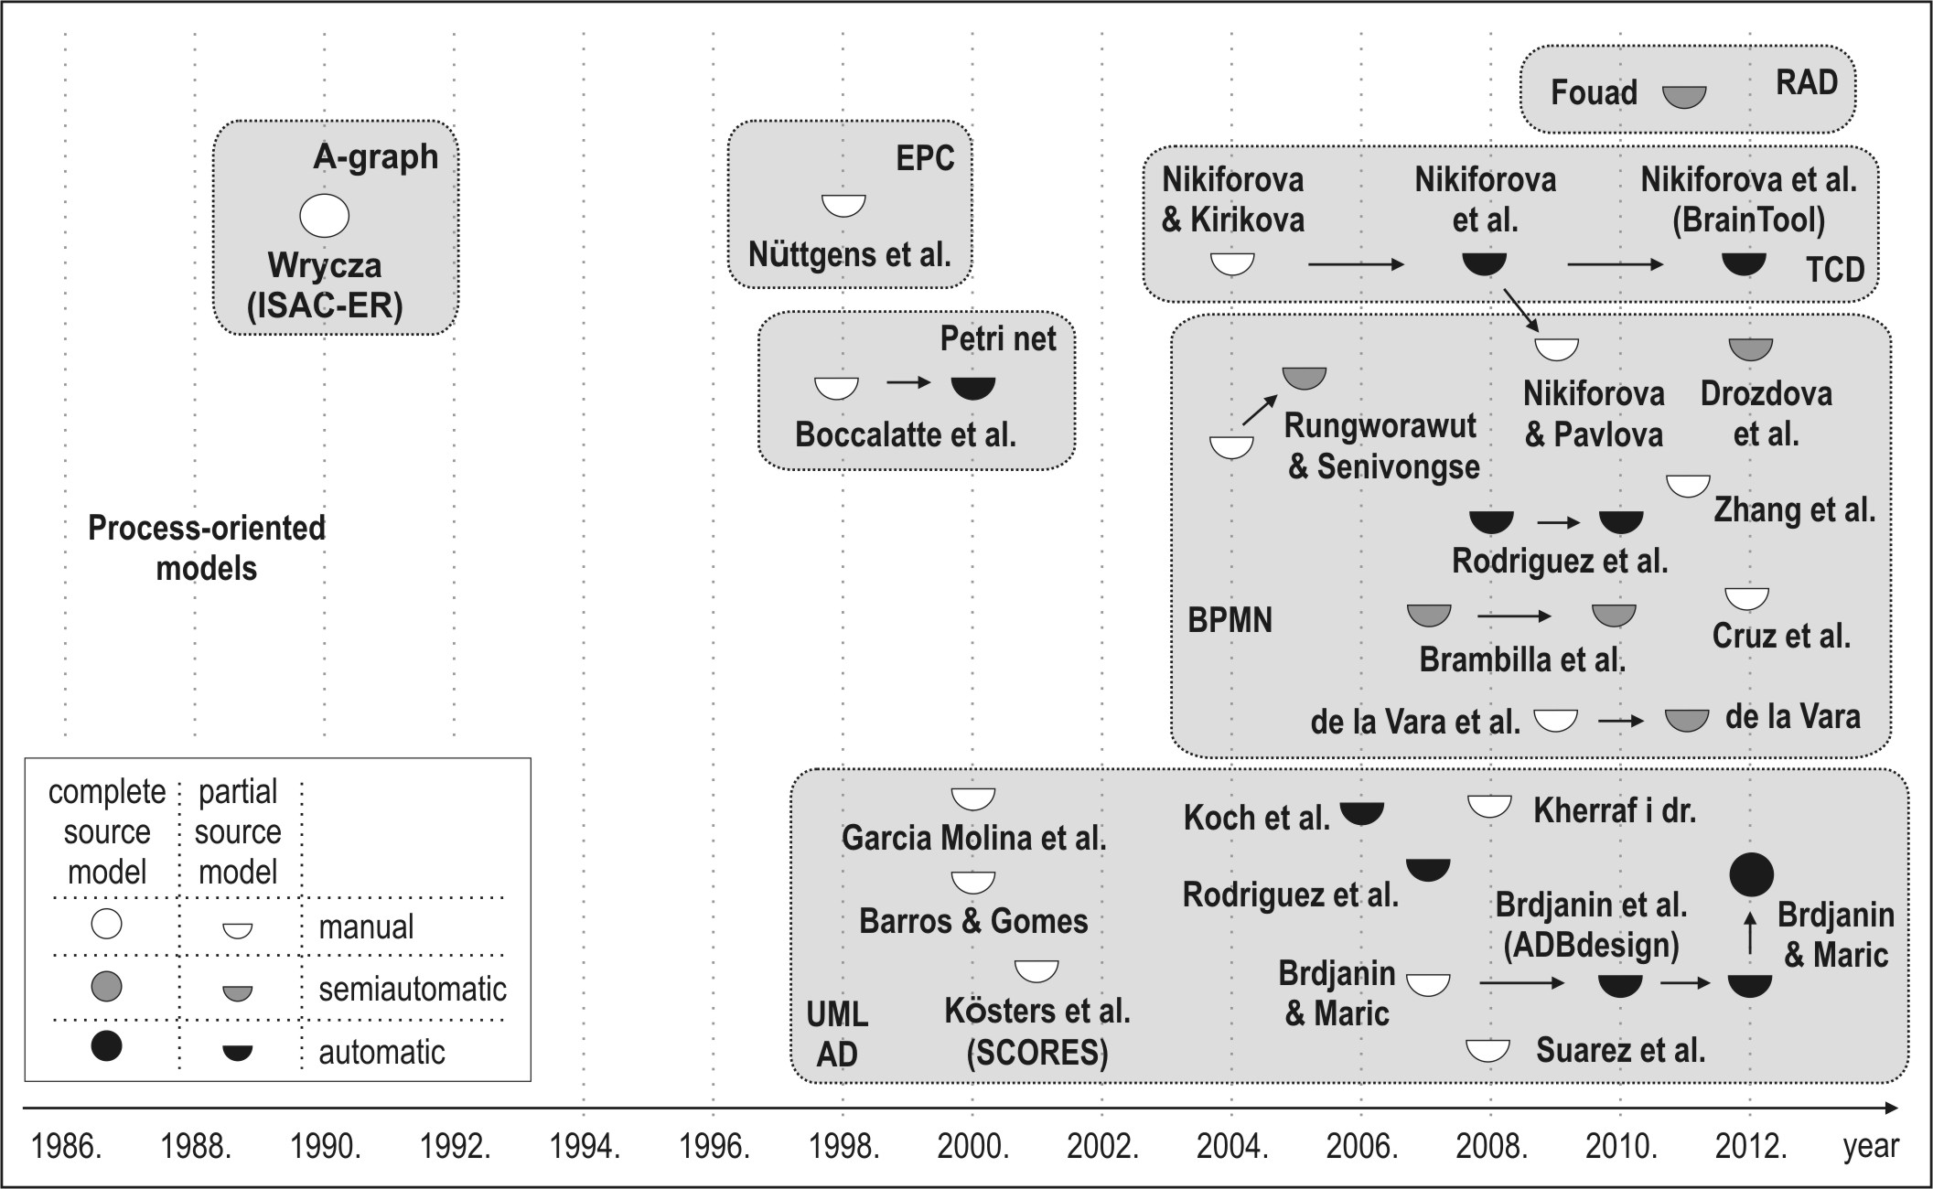
Process oriented approaches (1/4)
Chronological overview and main characteristics of PO approaches
Notes:
The main criterion for the differentiation between the process-oriented and function-oriented notations is the capacity for the explicit representation of a workflow.
GRAPES-BM/TCD> Large tasks are decomposed into chains of smaller ones using Task Communication Diagrams (TCD). These diagrams are the basic ones in GRAPES-BM.
RAD. Role Activity Diagram: a notation originally developed for software process modelling. RAD shows the roles, their component activities, and their interactions together with external events and the logic that determines what activities are carried out when. Have been used and promoted in the UK by both Praxis and Co-Ordination Systems.

Slide 15
Process oriented approaches (2/4)
Process-oriented models (POMs) are the largest category of models being used as a starting point for the MDSDM. The first data model synthesis based on the POM was proposed in 1990. The boom of these approaches was influenced by the appearance and development of metamodel-based notations, particularly the UML activity diagram (UML AD) in the late 1990s/early 2000s, and the BPMN a few years later, as well as the ATL and QVT transformation languages.
POMs, used as a basis for the MDSDM, have been represented by seven different notations: UML AD, BPMN, GRAPES-BM/TCD, Petri Net, RAD (Role Activity Diagram), EPC (Event-driven Process Chain) and A-graph.
The UML AD is used in 14 papers. Only one paper presents an automatic data model generator (named ADBdesign) based on the complete source model.
Several papers present the automated, mainly ATL and QVT-based, data model generation based on the incomplete source model, but with a modest precision (the percentage of correct automatically generated concepts) and recall (percentage of the automatically generated target model), while the others present manual data model derivation.

Slide 16
Process oriented approaches (3/4)
Although the BPMN is used in 12 papers, there is no paper presenting an automatic generator of the data model based on the complete source model. There are two QVT-based proposals, but with modest achievements in the automated generation of the analysis level class diagram, as well as several proposals for the semi-automated generation.
There are also several related papers proposing the usage of the TCD notation (a part of the GRAPES-BM language) as a starting point for data model synthesis, initially through the intermediate model, while the final release presents the BrainTool generator, which generates the data model directly from the TCD. However, like the majority of all proposals, they do not consider the complete source model, and the proposed approach is also not evaluated.
Among the remaining papers proposing data model synthesis based on Petri nets (2), EPC (1), A-graph (1), and RAD (1), only two sources present software tools for the (semi)automated generation of the data model based on the incomplete source model.

Slide 17
Process oriented approaches (4/4)
The survey of the POM based MDSDM approaches, shows that:
  (i) only two (5%) papers [5, 6] take the complete source model as a basis for data model synthesis;
  (ii) the target data model is predominantly represented by the UML class diagram (>90%), while the E-R is used only in 3 approaches;
  (iii) the majority of proposed approaches are based on guidelines (30%) and informal rules (40%). The development of transformation languages (ATL and QVT) influenced development of more formal and automated approaches (percentage of (semi)automatic techniques raised to ~60%);
  (iv) a small percentage (10%) of approaches (4) were evaluated based on a controlled experiment or a single case study, while all others were not evaluated at all, or just were illustrated by some examples, without any quantitative/qualitative evaluation;
  (v) only one paper [6] presents an automatic data model generator based on the complete source model, but the generated data model can be considered just as an initial (analysis level) data model;
  (vi) the semantic capacity of POMs has not yet been sufficiently identified to enable the automatic synthesis of the complete target data model.

Slide 18
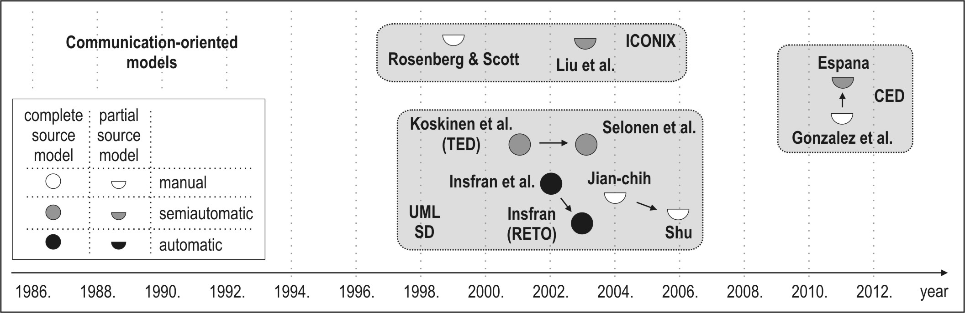
Communication oriented approaches (1/3)
Chronological overview and main characteristics of CO approaches
Notes:
ICONIX process is UML Use Case driven but more lightweight than RUP. Unlike the XP and Agile approaches, ICONIX provides sufficient requirement and design documentation, but without analysis paralysis. The ICONIX Process uses only four UML based diagrams in a four step process that turns use case text into working code.

Slide 19
Communication oriented approaches (2/3)
Communication-oriented models (COMs) constitute a smaller category of models used for data model synthesis.
COMs, used as a starting point for data model synthesis, have been represented by three different notations: UML SD (Sequence Diagram), ICONIX (Robustness Diagram) and CED (Communicative Event Diagram).
The UML SD was identified in six (60% of this category) sources as a source notation for data model synthesis. According to [7], transformations from sequence to class diagrams can be classified as strong, which implies that the source model possesses a semantic capacity only for the semiautomatic synthesis of the target data model.
The semantic capacity of the UML SD can be augmented by the specializa-tion of the standard notation, and the process of data model synthesis can be automatic, as in the RETO tool.
The process of data model synthesis in other two studies based on UML SD is manual.
Among the remaining proposals for data model synthesis based on the CED and the ICONIX, the semiautomatic synthesis of the data model is proposed in 2 sources, while others propose the guidelines for manual data model. synthesis.

Slide 20
Communication oriented approaches (3/3)
The survey of the COM based MDSDM approaches, shows that:
  (i) The majority (60%) of papers take the incomplete source model as a basis for data model synthesis;
  (ii) the target data model is exclusively represented by the UML class diagram;
  (iii) although the majority (70%) of papers are based on guidelines and informal rules, the majority (60%) of papers still present (semi)automated techniques for data model synthesis;
  (iv) only one (10%) proposal was evaluated based on a controlled experiment, while all others were not evaluated;
  (v) only one primary study presents an automatic data model generator based on the complete source model, but with a modest recall of some association types and without proper evaluation.

Slide 21
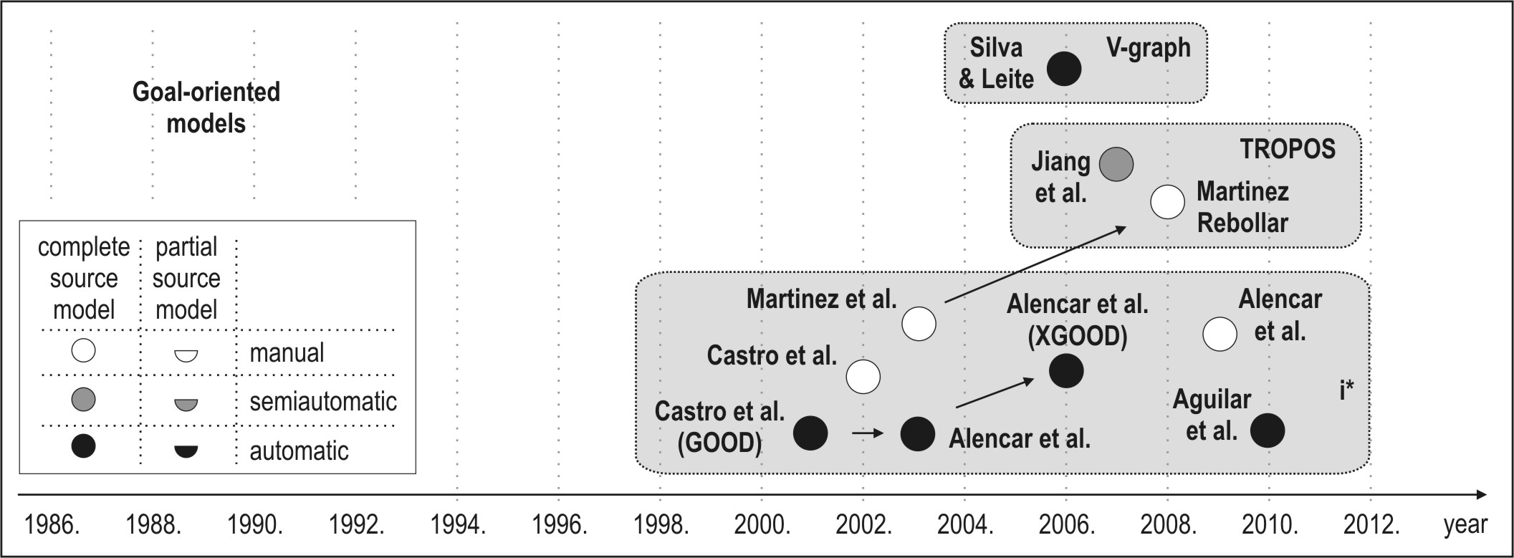
Goal oriented approaches (1/3)
Chronological overview and main characteristics of GO approaches
Notes:
The i* framework proposes an agent-oriented approach to requirements engineering centering on the intentional characteristics of the agent. Agents attribute intentional properties (such as goals, beliefs, abilities, commitments) to each other and reason about strategic relationships. Dependencies between agents give rise to opportunities as well as vulnerabilities. Networks of dependencies are analyzed using a qualitative reasoning approach. Agents consider alternative configurations of dependencies to assess their strategic positioning in a social context.
The framework is used in contexts in which there are multiple parties (or autonomous units) with strategic interests which may be reinforcing or conflicting in relation to each other. Examples of such contexts include: business process redesign, business redesign, information systems requirements engineering, analyzing the social embedding of information technology, and the design of agent-based software systems.

Slide 22
Goal oriented approaches (2/3)
Goal-oriented models (GOMs) are the main artifacts produced in the early phases of goal-oriented requirements engineering processes, constitute the fourth category of models used for data model synthesis.
GOMs, use i* notation and some i* -originated notations like TROPOS and V-graph.
i* models were identified in eight (>70% of the entire category) papers as a basis for data model synthesis. Most of the identified papers present the automatic synthesis of the data model to some extent, while only two papers present manual data model derivation. Most of the papers reporting automated data model synthesis are mutually related and present improvements in the same approach and the same tool named GOOD/XGOOD. Other proposals based on TROPOS models and V-graph are also mainly automated to some extent, but not evaluated.

Slide 23
Goal oriented approaches (3/3)
The survey of the COM based MDSDM approaches, shows that:
  (i) Since i* and i* -originated notations enable the representation of functional and non-functional requirements by a unique diagram (but with difficult "readability"), all identified papers take the complete source model as a basis for data model synthesis;
  (ii) the target data model is exclusively represented by the UML class diagram;
  (iii) the large majority (>90%) of papers are based on guidelines and informal rules;
  (iv) the majority (> 60%) of papers present (semi)automated techniques for data model synthesis, but the recall might be estimated as insufficient and there is no evaluated approach at all.

Slide 24
Comparative analysis (1/3)
As presented, all papers were analyzed according to the following criteria:
  Source notation - a notation used for the source model representation;
  Source model completeness - a source model might be considered as complete or partial (complete/partial representation of requirements);
  Target notation - a notation used for the data model representation;
  Level of formalism - data model synthesis might be driven by guidelines, informal rules or by formal rules;
  Level of automatization - data model synthesis might be considered as manual (not supported by any software tool), semiautomatic (supported by a tool, but the designer's assistance is still required) or automatic (without designer's assistance);
  Approach evaluation - an approach might be considered as evaluated (based on a controlled experiment or a case study) or not evaluated.
Different marks are used to differentiate the source model completeness and the level of automatization. The arrows were used to emphasize the related papers presenting the improvements in the same approach.
Notes:
Level of formalism - data model synthesis might be driven by guidelines (synthesis is generally described without rules for data model synthesis), informal rules (rules specied in a natural language) or by formal rules (rules formally represented by a transformation language, formal algorithm, predicate logic, etc.);

Slide 25
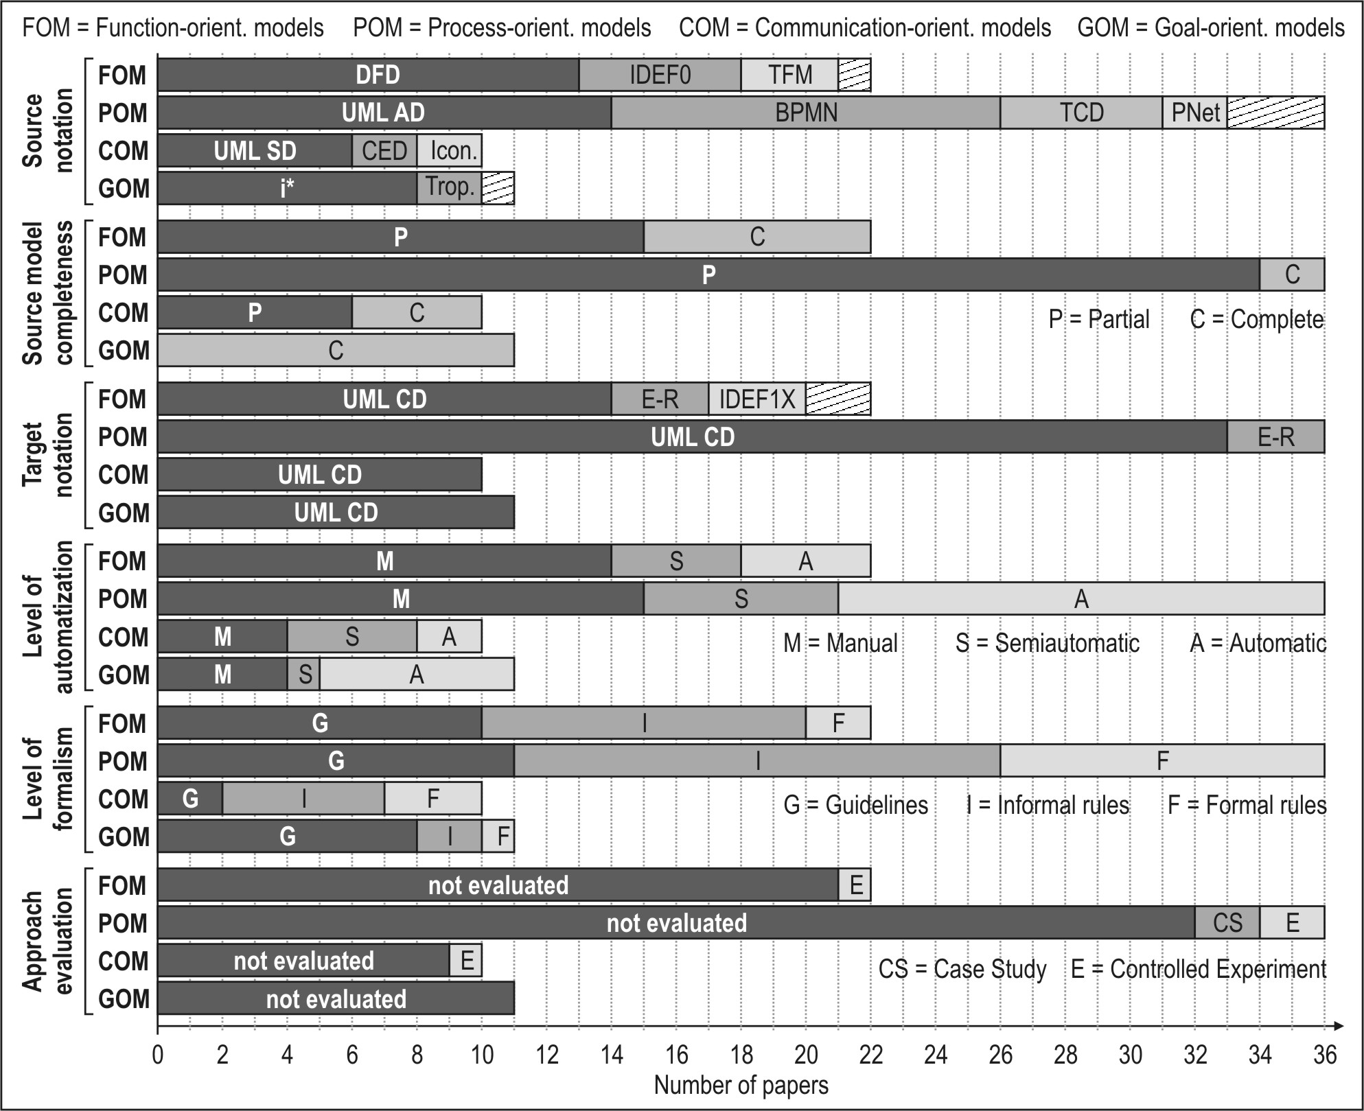
Comparative analysis (2/3)
Main characteristics of MDSDM approaches

Slide 26
Comparative analysis (3/3)
The analysis implies that :
  POMs and FOMs are predominantly (>70%) used as a basis for the MDSDM.
  Three notations (UML AD, DFD, BPMN), belonging to these two categories, are used in half of all identified sources.
  Most of the papers (70%) do not take the complete source model, but only incomplete, i.e. the partial model of business or system requirements, as a basis for data model synthesis.
  The UML class diagram is used for the representation of the target data model in a large majority (>85%) of all identified papers. Other notations were mainly used in some approaches before the adoption of the UML standard.
Notes:
POMs and FOMs are predominantly (>70%) used as a basis for the MDSDM.
Three notations (UML AD, DFD, BPMN), belonging to these two categories, are used in half of all identified sources. The DFD, as a traditional function-oriented notation, still constitutes the subject of research in the field of MDSDM, but it loses the precedence to the newer, metamodel-based notations UML AD and BPMN, as well as the goal-oriented notations.
Most of the papers (70%) do not take the complete source model, but only incomplete, i.e. the partial model of business or system requirements, as a basis for data model synthesis. The incompleteness of the source model is a typical characteristic of all categories, except for approaches having GOMs as a basis for data model synthesis, since all of them are based on the i* notation, which captures "all" requirements by a single diagram.
The UML class diagram is used for the representation of the target data model in a large majority (>85%) of all identified papers. Other notations were mainly used in some approaches before the adoption of the UML standard.

Slide 27
Comparative analysis (3/3)
  Data model synthesis is mainly ( 80%) informally specified, equally by guidelines and informal rules, while just one-fifth of all papers specify data model synthesis in some formal way.
  The development of transformation languages (ATL and QVT) has made a significant contribution to the formalization and automatization of data model synthesis in the recent years, so the participation of automatic techniques (35%) is growing.
  A deeper analysis implies that the semantic capacity of graphically represented business/software requirements (regardless of their orientation) has not yet been sufficiently identified to enable the automatic synthesis of the complete target data model, since a large majority of the existing approaches still do not have a significant recall in the automated generation of class associations, association end multiplicities and class members.
Notes:
Data model synthesis is mainly ( 80%) informally specified, equally by guidelines and informal rules, while just one-fifth of all papers specify data model synthesis in some formal way. Consequently, the level of automatization is rather low - a half of all papers present only manual data model derivation, while the other half present (semi)automated data model generation to some extent.
The development of transformation languages (ATL and QVT) has made a significant contribution to the formalization and automatization of data model synthesis in the recent years, so the participation of automatic techniques (35%) is growing.
A deeper analysis implies that the semantic capacity of graphically represented business/software requirements (regardless of their orientation) has not yet been sufficiently identified to enable the automatic synthesis of the complete target data model, since a large majority of the existing approaches still do not have a significant recall in the automated generation of class associations, association end multiplicities and class members.

Slide 28
Comparative analysis (3/3)
  More than 90% of the analyzed approaches are not evaluated at all, while the evaluation in the evaluated papers was mainly focused on the approach usability, but not on the qualitative/quantitative measures for the implemented tools and generated data models.

Slide 29
Conclusion
The results of the survey of model-driven techniques for data model synthesis were presented. During the extensive research, we identified more than 70 research papers in the field, and more than 15 different notations used for the source model representation.
Through this research the unique classification of approaches into four distinct groups was given: function-oriented, process-oriented, communication-oriented and goal-oriented, we gave the chronological overview of all identified papers classified according to the introduced classification, as well as the analysis and evaluation of the MDSDM approaches based on several main criteria.
Although the idea of model-driven design of the data model is more than 25 years old, the survey shows that only a small number of papers present the implemented automatic model-driven generator of the data model and the corresponding evaluation results. The main reason for the modest achieve-ments in the automated model-driven design of the data model lies in the insufficiently identified semantic capacity of models used to represent business/ software requirements for the automatic synthesis of the complete target data model.
fi
29

Slide 30
References
Jilani, A.A.A., Usman, M., Nadeem, A., Malik, Z.I., Halim, Z.: Comparative study on DFD to UML diagrams transformations. WCSIT 1(1) (2011) 10 -16.
Franch, X., Mate, A., Trujillo, J.C., Cares, C.: On the joint use of i* with other modeling frameworks: a vision paper. In: Proc. of RE '11, IEEE (2011) 133-142.
Loniewski, G., Insfran, E., Abrahao, S.: A systematic review of the use of requirements engineering techniques in model-driven development. In Petriu, D.C, Rouquette, N., Haugen, eds.: MODELS 2010. Volume 6395 of LNCS. Springer-Verlag, Berlin Heidelberg (2010) 213-227
Yue, T., Briand, L.C., Labiche, Y.: A systematic review of transformation approaches between user requirements and analysis models. Requirements Engineering 16(2) (2011) 75-99.
Wrycza, S.: The ISAC-driven transition between requirements analysis and ER conceptual modelling. Information Systems 15(6) (1990) 603-614.
Brdjanin, D., Maric, S.: Towards the automated business model-driven conceptual database design. In Morzy, T., Harder, T., Wrembel, R., eds.: Advances in Databases and Information Systems. Volume 186 of AISC. Springer-Verlag, Berlin Heidelberg (2012) 31-43.
Selonen, P., Koskimies, K., Sakkinen, M.: Transformations Between UML Diagrams. Journal of Database Management 14(3) (2003) 37-55.

Slide 31

26.08-31.08.2013.
13th Workshop
“Software Engineering Education and Reverse Engineering"
Dražen Brđanin, Slavko Marić
University of Banja Luka, Bosnia and Herzegovina
Survey of model-driven techniques
for database model synthesis
Thank You!

